Slide 1
Unveiling Bengali Voices: WHISPER-Powered Speech Recognition for Regional Dialects
নড়াইল
চট্টগ্রাম
রংপুর
Team: DU_Ottercat
Private Score: 0.78531

Slide 2
Our team
Ahaj Mahhin Faiak
S. M. Imran Rahman
Computer Science & Engineering, University of Dhaka
Computer Science & Engineering, University of Dhaka
Md. Sadman Sakib
Computer Science & Engineering, University of Dhaka

Slide 3
Agenda
01
02
03
04
Introduction
Analysis & Methodology
Future Work
Conclusion

Slide 4
01
Introduction

Slide 5

Problem Dimension : Dialectology
Engage in transcription of Bengali speech with various regional dialects following the orthography set by linguists
By conducting thorough analysis, we revealed the varied linguistic characteristics of Bengali across various regions within Bangladesh.
Source: https://mapsontheweb.zoom-maps.com/post/722437050870218752/dialects-of-bengali-bangla-language

Slide 6
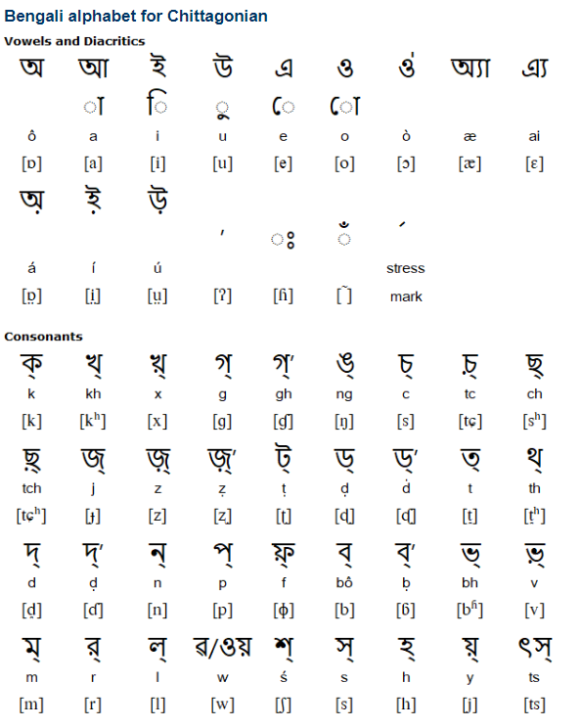
Problem Dimension : Cultural Revelation
A platform aimed at discovering the cultural nuances ingrained within the Bengali language.
Highlighted the interplay of social interactions, geographic backgrounds, and historical accounts mirrored in the language, thereby presenting the intricate fabric of Bangladesh's cultural legacy.
Source: https://www.omniglot.com/writing/chittagonian.htm

Slide 7
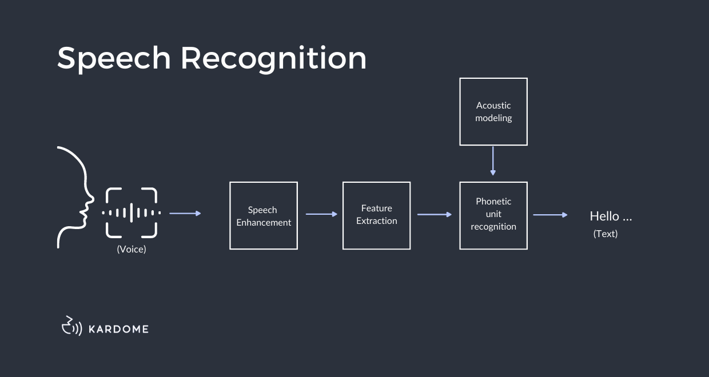
Problem Dimension : Technological Advancement
Develop a solution system capable of transcribing Bengali speech, encompassing diverse regional dialects while adhering to the standardized orthography established by linguists
Elevating Bengali from its perception as a language with limited resources to one that is universally accessible and inclusive

Slide 8
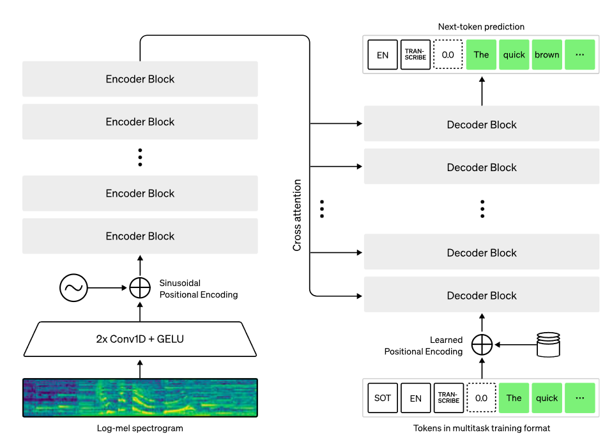

Introducing Whisper
Whisper is an ASR system that has been trained on a vast dataset of 680,000 hours comprising multilingual and multitask supervised data sourced from the internet. The utilization of such an extensive and varied dataset enhances its ability to handle accents, background noise, and technical language. Furthermore, this approach facilitates transcription across multiple languages and enables translation into English from those languages.
About a third of Whisper’s audio dataset is non-English, which highly inspired us to use it in our solution.

Slide 9
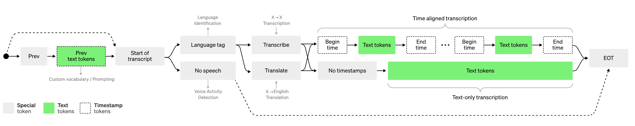
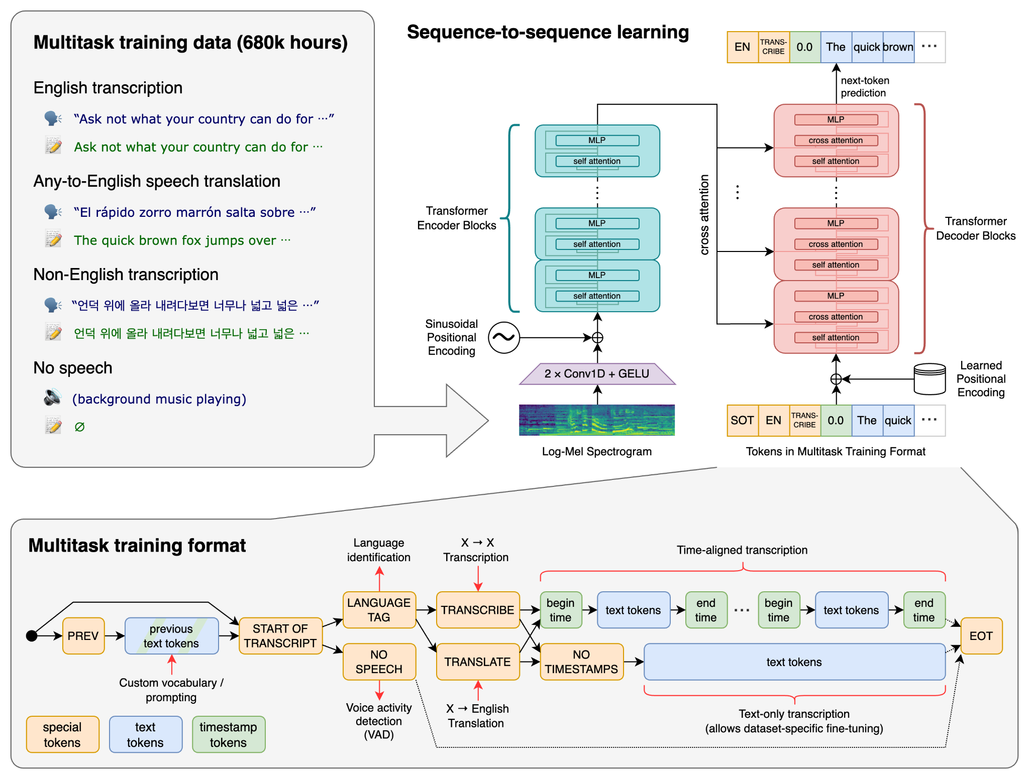
The Whisper architecture adopts a straightforward end-to-end methodology, structured as an encoder-decoder Transformer. Initially, the input audio undergoes segmentation into 30-second segments, followed by conversion into a log-Mel spectrogram. Subsequently, this spectrogram is fed into an encoder. Meanwhile, a decoder is trained to generate the corresponding text captions, interspersed with special tokens. These tokens serve to guide the single model in performing various tasks, including language identification, phrase-level timestamps, multilingual speech transcription, and translation of speech to English.

Slide 10
02
Analysis & Methodology

Slide 11
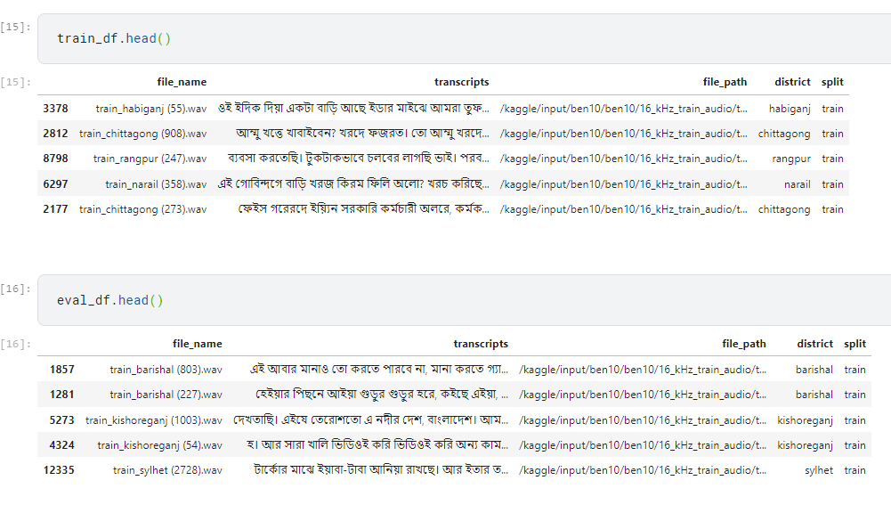
Observations About Data
Number of Training samples: 13473
Number of Testing samples: 137

Slide 12
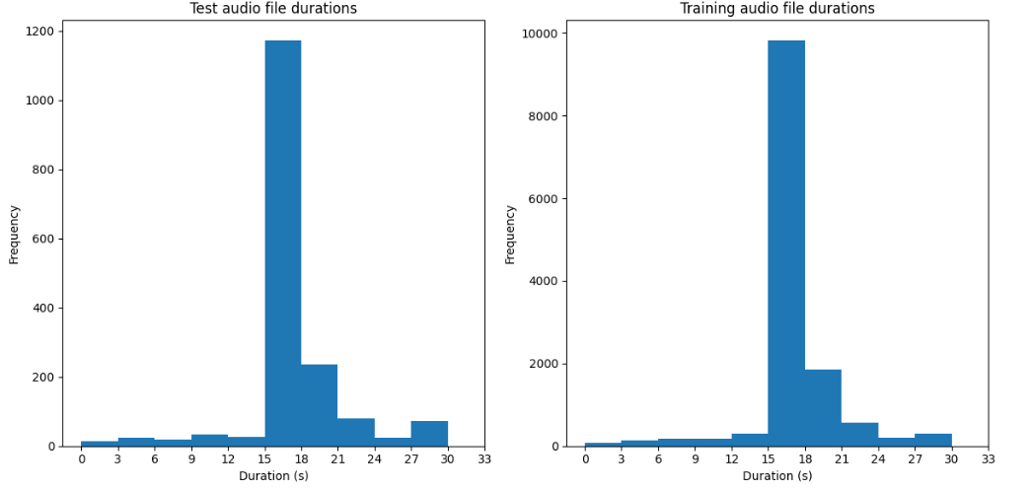
Distribution of the Duration of audio signals are IDENTICAL

Slide 13
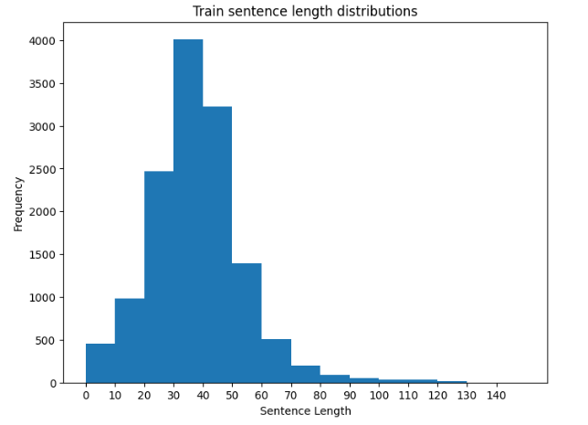
Train Sentence’s Length Distribution

Slide 14
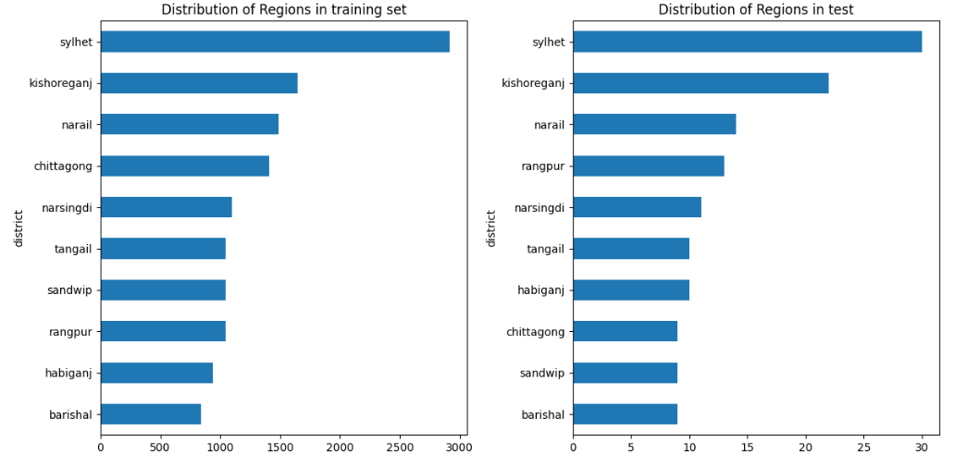
District Wise Distribution (Train-Test)

Slide 15
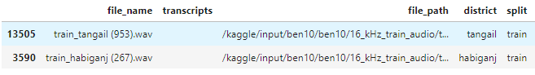
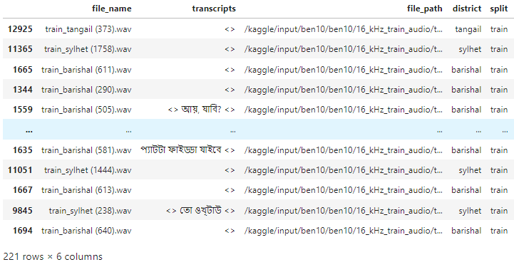
Training Dataset Contains Invalid Transcripts
Key Points:
Lots of transcripts contains unwanted characters
A lot of the transcripts are really small for the model to train

Slide 16
Post Processing & Preprocessing Techniques

Slide 17
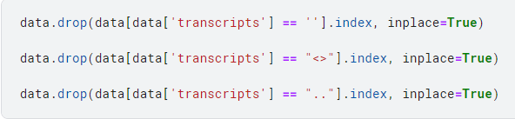
Preprocessing 1 : Drop Data with Invalid Transcripts

Slide 18
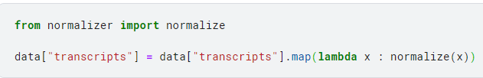
Preprocessing 2 : Normalize Data

Slide 19
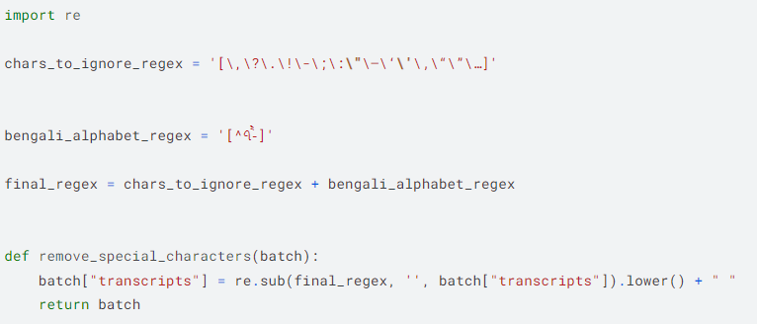
Preprocessing 3 : Remove Unnecessary Character

Slide 20
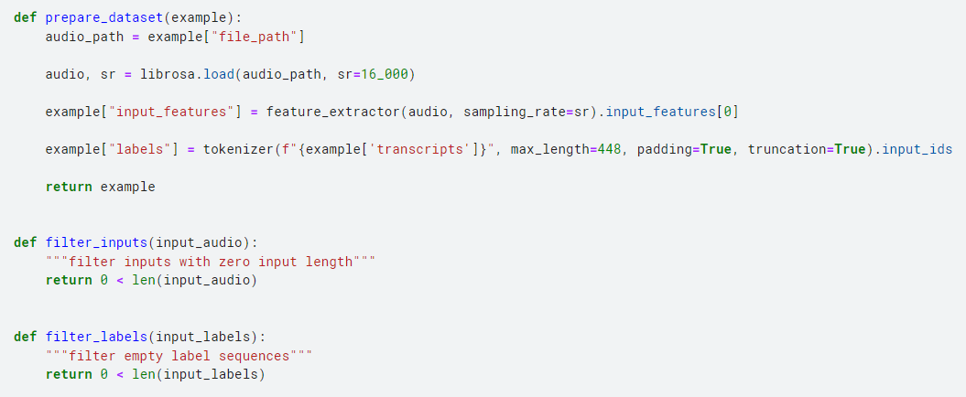
Preprocessing 4 : Filter Audio Signals

Slide 21
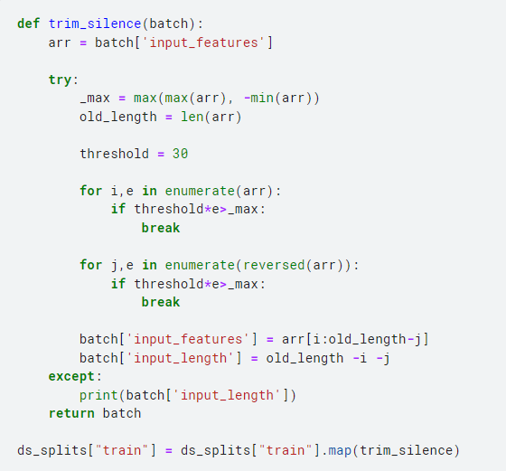
Preprocessing 5 : Trim Silence parts from the audio signals

Slide 22
Preprocessing 5 : Trim Silenced parts from the audio signals

Slide 23
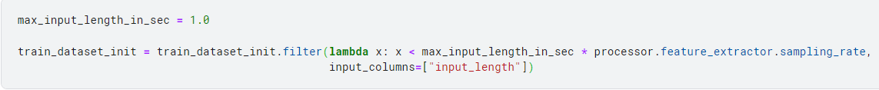
Preprocessing 6 : Removing Large Audio Signals

Slide 24
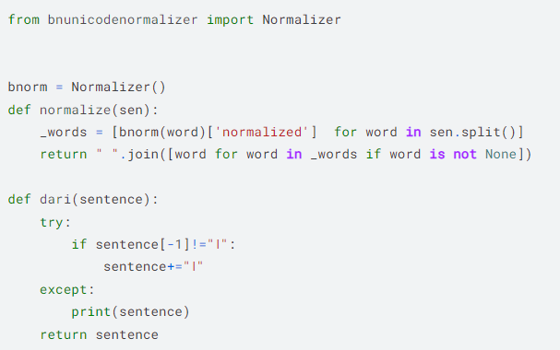
Postprocessing 1 : Normalize Prediction and ADD Dari

Slide 25
03
Model Training

Slide 26
Training Hyperparameter
Model : WHISPER -small
Learning rate : 2e-4
Number of epochs : 5
Optimizer : Adam
Batch size : 12

Slide 27
Result
Public Score : 0.80093
Private Score: 0.80019

Slide 28
Training Hyperparameter
Model : WHISPER -small
Learning rate : 2e-5
Number of epochs : 5
Optimizer : Adam
Batch size : 12

Slide 29
Result
Public Score : 0.79644
Private Score: 0.78871

Slide 30
Training Hyperparameter
Model : WHISPER -small
Learning rate : 2e-4
Number of epochs : 4
Optimizer : Adam
Batch size : 12

Slide 31
Result
Public Score : 0.78729
Private Score: 0.78531

Slide 32
We trained Wav2vec Model too !!!
Public Score : 0.998
Private Score : 0.998

Slide 33
03
Future Work

Slide 34
Still Need Improvements!
Need to fine-tune a Punctuation model
Make the sounds clearer and remove noises
Identify the dominant speaker during speeches
Attempt usage of LLM models

Slide 35
04
Conclusion

Slide 36
Concluding Thoughts
Comprehensive Coverage of Models
Fine-tuning ASR models
Significant Contribution in Bangla
Future Directions
Pre and Post Processing Bangla

Slide 37
Any Query?!
Mail:
ahaj-2020215611@cs.du.ac.bd
mdsadman-202015659@cs.du.ac.bd
imranrahman543@gmail.com

